Slide 1
Smart Traffic Management System

Slide 2
MOTIVATION/BACKGROUND:
The mismanagement of traffic and consequent congestion has arisen many problems
To reduce them, the idea of Smart Traffic Signal Management System has been suggested.
The current traffic controlling system is either manual or rigid which are inefficient methods.

Slide 3
ABSTRACT:
The increase in population has increased the number of vehicles. Today's traffic signals manage the traffic but are not much efficient. Congestion of traffic is a huge problem which is faced of daily basis. Primarily on 4-ways. Considering our own city Karachi, to reducing the problems, the idea of Smart Traffic Signal Management System has suggested. By creating our own data set based on images captured from within the city, the proposed project aims to make decisions for the traffic signal timings based on the vehicle densities. The project would deploy on a four-way traffic signal.

Slide 4
DESCRIPTION/METHODOLOGY:
The system uses video data collected of traffic from the roads of Karachi, Pakistan.
Image framing would capture frames from the video at several fixed intervals.
For detection machine learning algorithm, YOLO is performed over the recent frame.
The number of vehicles in the scene would be calculated.
Delay for the green light is set accordingly.

Slide 5
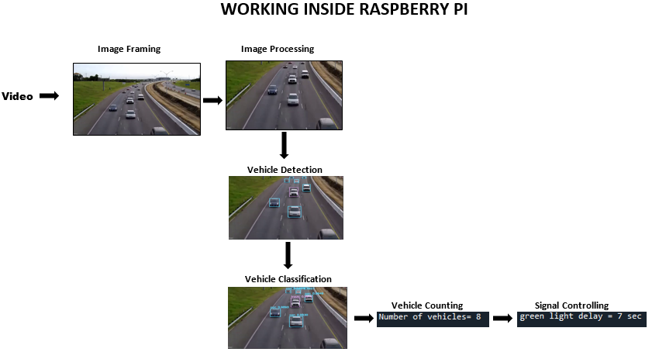
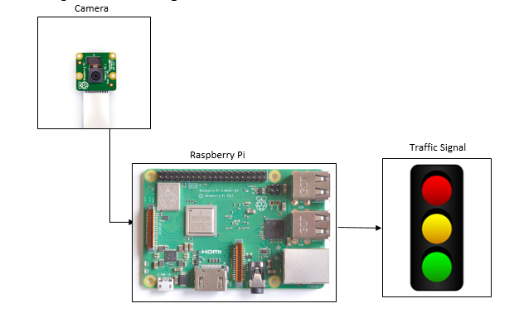
BLOCK DIAGRAM:

Slide 6
START
FLOW DIAGRAM:
RECORD VIDEO
IMAGE FRAMING
VEHICLE DETECTION
VEHCILE COUNTING
IS
COUNT< LOW
IS
COUNT<MEDIUM
IS
COUNT<HIGH
IS
COUNT<SUPERHIGH
TIME FOR GREEN LIGHT
TIME FOR GREEN LIGHT
TIME FOR GREEN LIGHT
TIME FOR GREEN LIGHT
REPEAT THE PROCEDURE

Slide 7
FEATURES:
Reduction in Traffic jams.
Reduction in time wastage.
Video log of traffic would be created at the backend.
Reduction in Pollution.

Slide 8
APPLICATIONS & FUTURE WORK:
In future it can be expanded for priority based traffic clearance to detect
It will be Providing priority emergency vehicles which will save a lot of lives and property.
Detection of number plates of all the vehicles will be a useful advancement in the system.

Slide 9
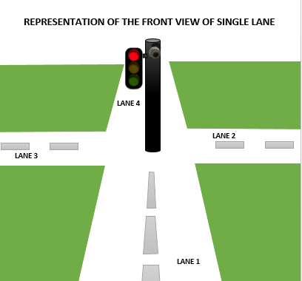
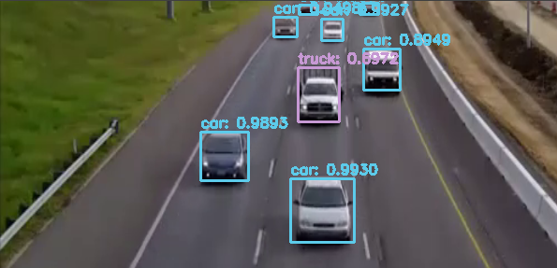

In this project traffic signal is controlled based on the density of its respective road. This is done using Image Processing and Machine Learning, which causes production costs to set low while achieving high speed and accuracy.
TENTATIVE OUTPUT:

